Slide 1
DIGICHROME ACADEMY
NEXT HIKES
2023-24

Slide 2
PROJECT – 02
DATA ACQUISTION & WRANGLING
ANKUR KUMAR GIRI
2023-24

Slide 3
INTRODUCTION
DATA ACQUISITION IS THE PROCESS OF COLLECTING. MEASURING, AND RECORDING INFORMATION FROM VARIOUS SOURCES IN THE REAL WORLD. THIS DATA CAN COME FROM SENSORS, INSTRUMENTS, INDUSTRIAL EQUIPMENT, OR EVEN MANUAL INPUT. IT’S OFTEN USED IN SCIENTIFIC RESEARCH, INDUSTRIAL MONITORING. AND CONTROL SYSTEM TO GATHER INFORMATION FOR ANALYSIS, VISUALIZATION, AND DECISION-MAKING.
DATA WRANGLING, ALSO KNOWN AS DATA MUNGING, IS THE PROCESS OF CLEANING, STRUCTURING. AND TRANSFORMING RAW DATA INTO A FORMAT SUITABLE FOR ANALYSIS. THIS OFTEN INVOLVES TASKS LIKE HANDLING MISSING VALUES, CORRECTING ERRORS, STANDARDIZING FORMAT, AND INTEGRATING DATA FROM MULTIPLE SOURCES. DATA WRANGLING IS A CRUCIAL STEP IN THE DATA ANALYSIS PIPELINE, ENSURING THAT THE DATA IS ACCURATE, CONSISTENT, AND READY FOR FURTHER ANALYSIS OR MODELING.

Slide 4
Data Acquistion & Wrangling
CONTENTS
PROJECT OBJECTIVE
METHODS (COUNT.)
SOFTWARE REQUIREMENTS
FLOW CHART OF DATA ACQUISTION & WRANGLING MODEL.

Slide 5
DATA ACQUISITION
PROJECT OBJECTIVE
IN A DATA ACQUISITION PROJECT, THE OBJECTIVES TYPICALLY REVOLVE AROUND COLLECTING SPECIFIC DATA TO ACHIEVE A PARTICULAR GOAL OR SOLVE A PROBLEM. THESE OBJECTIVES COULD INCLUDE.
IDENTIFYING AND CAPTURING RELEVANT DATA SOURCES: DETERMINE THE SOURCES OF DATA NECESSARY TO ADDRESS THE PROJECT’S GOALS.
DESIGNING DATA COLLECTION METHODS: DEVELOP PROTOCOLS AND SYSTEMS FOR COLLECTING DATA FROM THE IDENTIFIED SOURCES EFFICIENTLY AND ACCURATELY.
ENSURING DATA QUALITY: IMPLEMENT PROCEDURES TO MAINTAIN DATA INTEGRITY, INCLUDING ERROR CHECKING, VALIDATION AND CLEANING.

Slide 6
DATA ACQUISITION
PROJECT OBJECTIVE
ESTABLISHING DATA STORAGE AND MANAGEMENT: SET UP SYSTEMS FOR STORING, ORGANIZING, AND MANAGING THE COLLECTED DATA SECURELY.
ANALYZING AND INTERPRETING DATA: USE THE ACQUIRED DATA TO GAIN INSIGHTS, MAKE PREDICTIONS, OR SOLVE PROBLEMS RELEVANT TO THE PROJECT’S OBJECTIVES.
6. COMMUNICATING FINDINGS: PRESENT THE RESULTS OF THE DATA ANALYSIS IN A CLEAR AND UNDERSTANDABLE MANNER TO STAKEHOLDERS, DECISION-MAKERS, OR OTHER INTERESTED PARTIES.

Slide 7
DATA WRANGLING
PROJECT OBJECTIVE
DATA WRANGLING, SOMETIMES REFERRED TO AS DATA MUNGING, IS THE PROCESS OF CLEANING, STRUCTURING, AND ENRICHING RAW DATA INTO A DESIRED FORMAT FOR BETTER DECISION-MAKING IN ANALYSIS. IT INVOLVES SEVERAL STEPS SUCH AS:
DATA COLLECTION: GATHERING DATA FROM VARIOUS SOURCES SUCH AS DATABASES, APIS, FILES, ETC.
DATA CLEANING: IDENTIFYING AND CORRECTING ERRORS OR INCONSISTENCIES IN THE DATA, SUCH AS MISSING VALUES, DUPLICATES, OR OUTLIERS.
3. DATA TRANSFORMATION: RESTRUCTURING OR CONVERTING DATA INTO A MORE SUITABLE FORMAT FOR ANALYSIS. THIS MIGHT INCLUDE NORMALIZATION, AGGREGATION, OR RESHAPING DATA.

Slide 8
DATA WRANGLING
PROJECT OBJECTIVE
DATA ENRICHMENT: ENHANCING THE DATASET WITH ADDITIONAL INFORMATION, SUCH AS MERGING WITH OTHER DATASETS OR ADDING CALCULATED FIELDS.
DATA VALIDATION: CHECKING THE QUALITY AND INTEGRITY OF THE DATA TO ENSURE IT MEETS THE DESIRED STANDARDS AND IS SUITABLE FOR ANALYSIS.
6. DATA EXPLORATION: EXPLORING THE CLEANED AND TRANSFORMED DATA TO GAIN INSIGHTS AND IDENTIFY PATTERNS OR RELATIONSHIPS.

Slide 9
METHODS (COUNT.)
DATA ACQUISITION
DATA WRANGLING
TOOLS
ITERATIVE PROCESS
DOCUMENTATION
VALIDATION

Slide 10
SOFTWARE REQUIREMENTS
GOOGLE DRIVE
COLAB

Slide 11
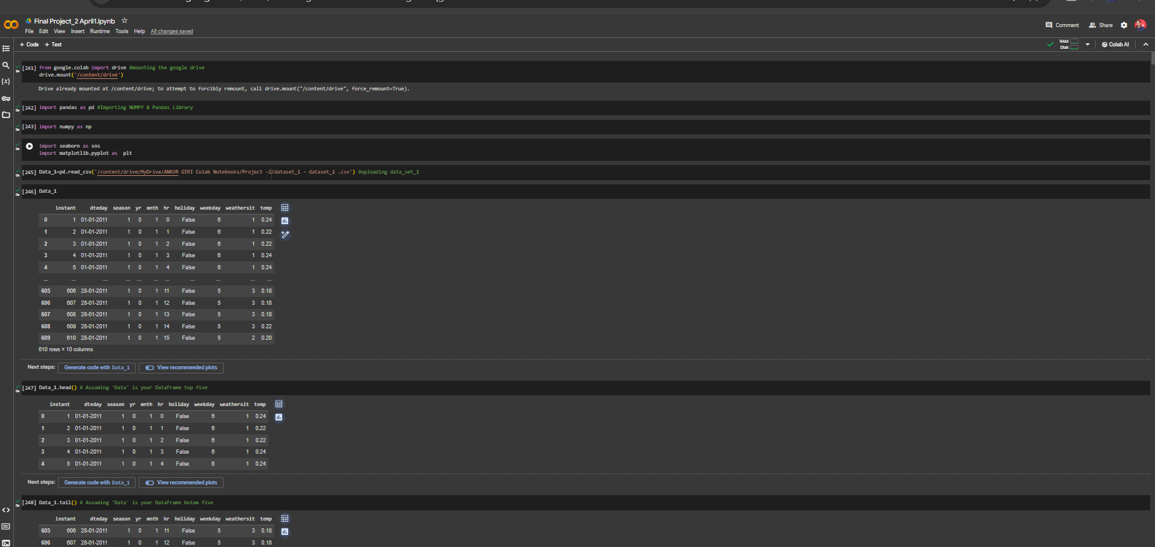

Slide 12
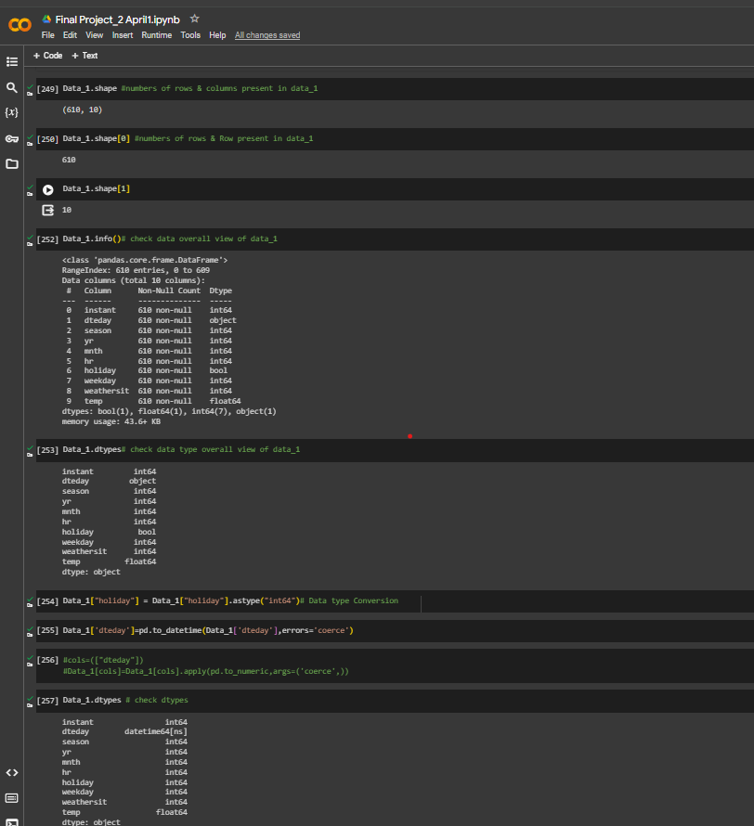
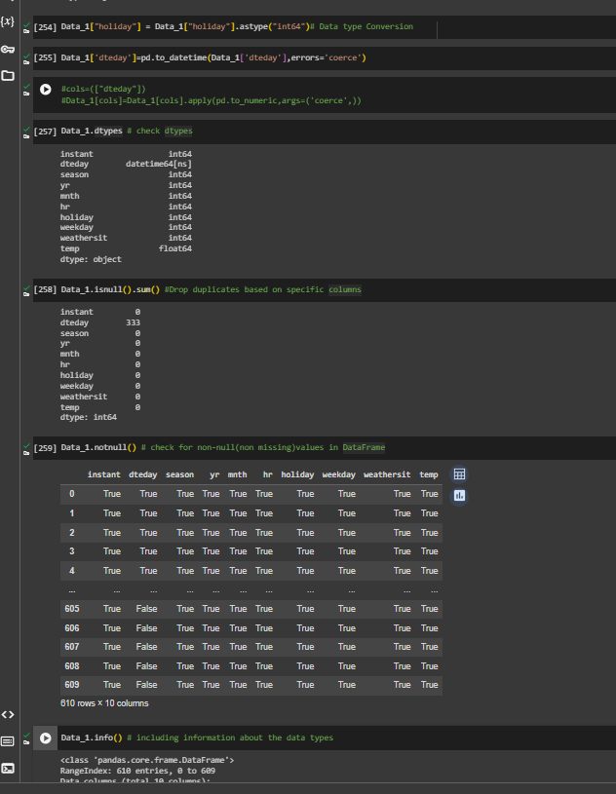

Slide 13
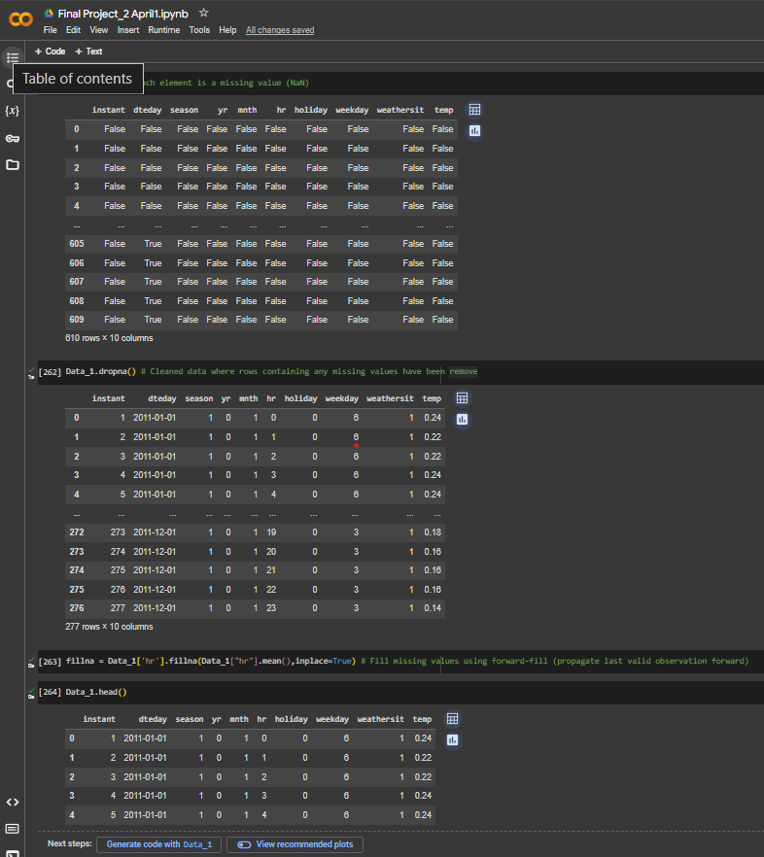
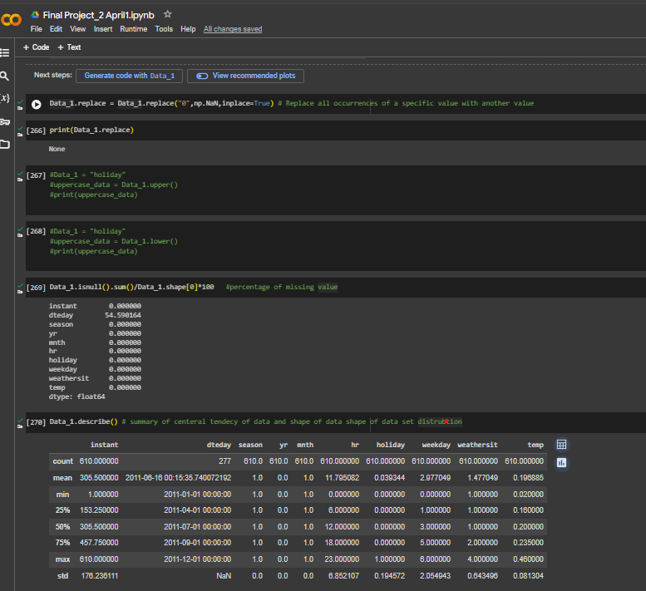

Slide 14
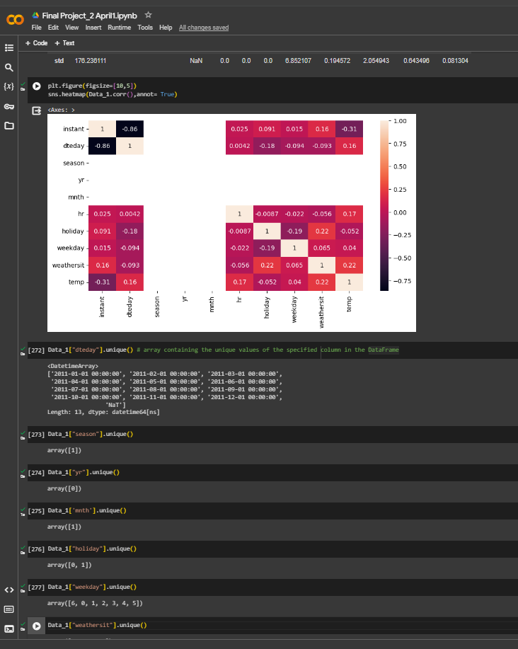
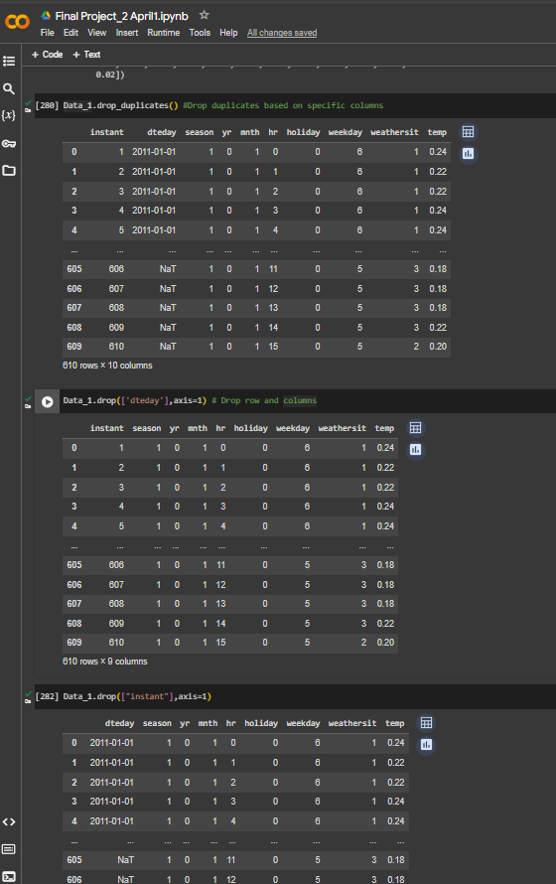

Slide 15
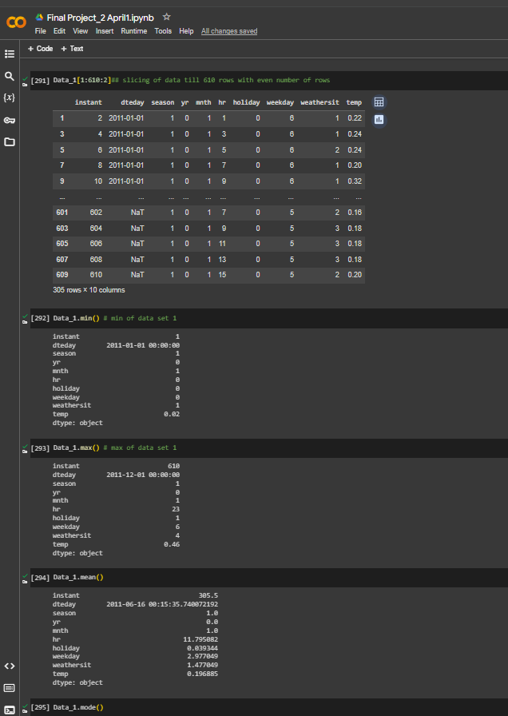
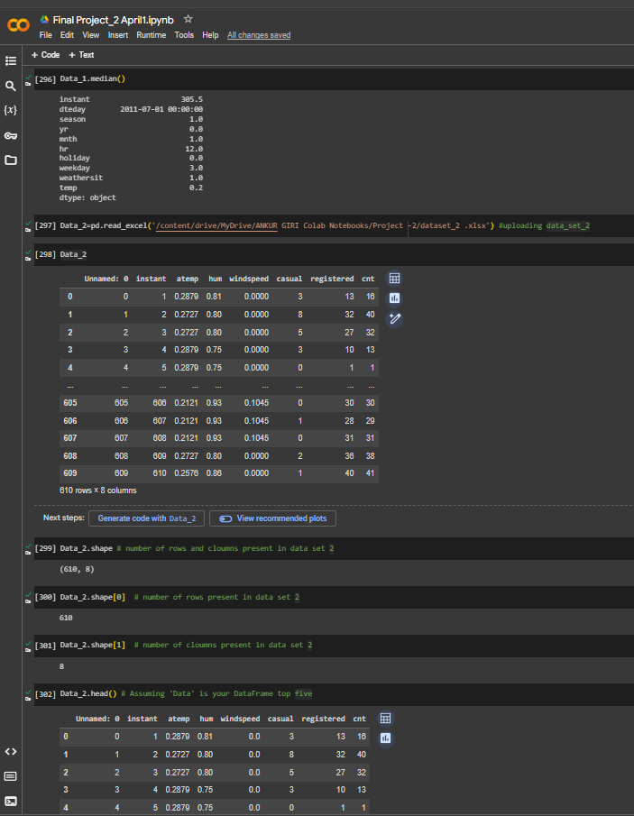

Slide 16
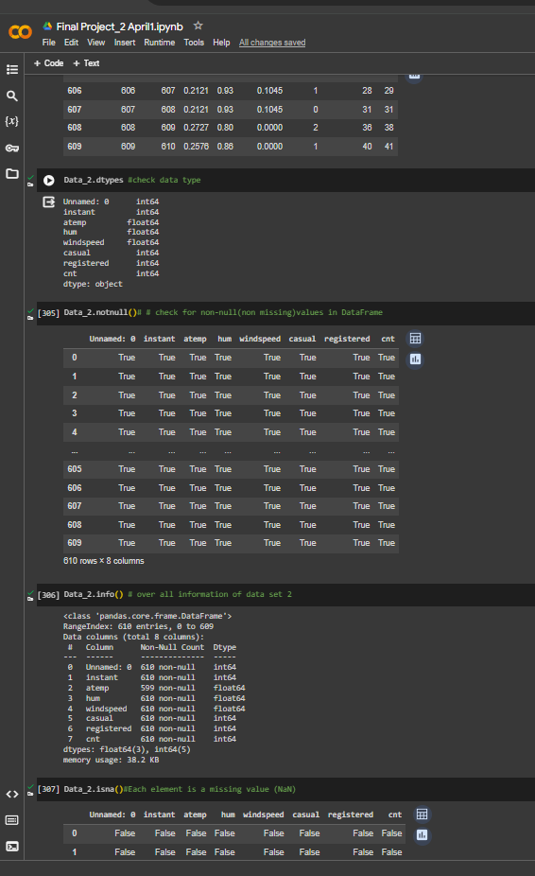
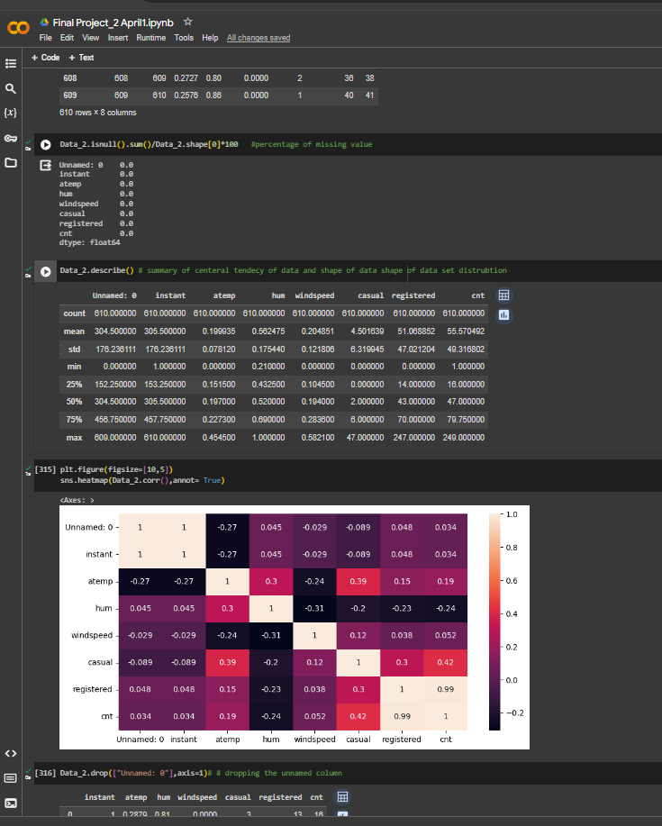

Slide 17
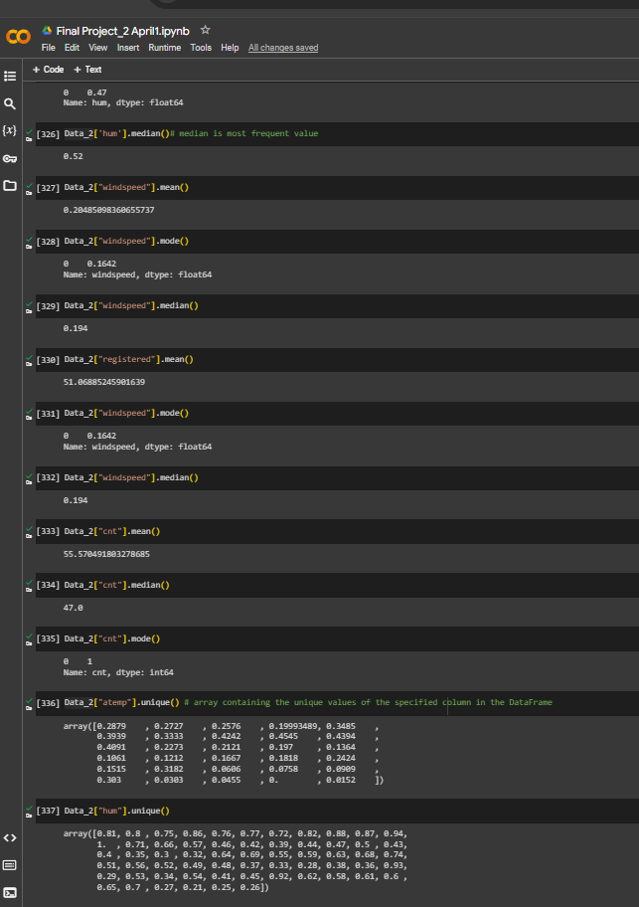
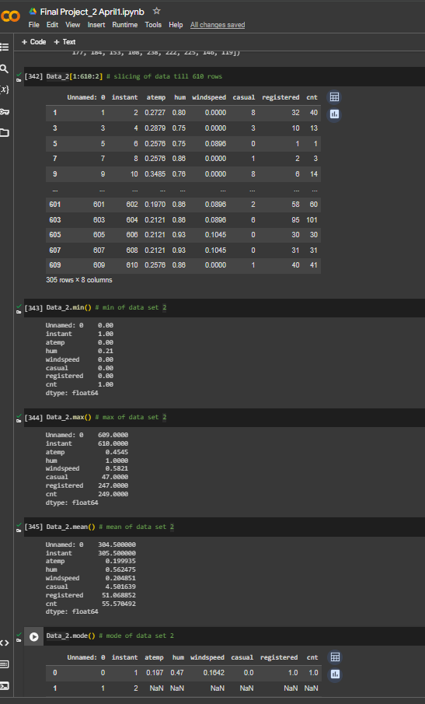

Slide 18
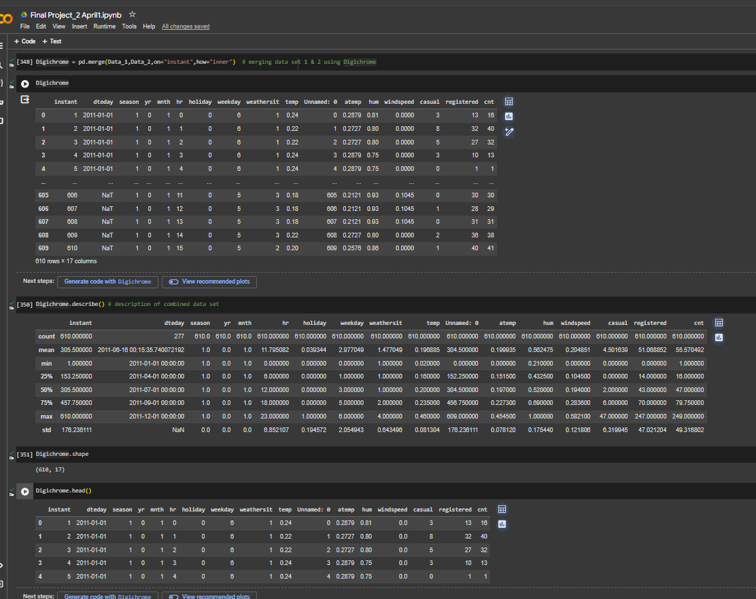
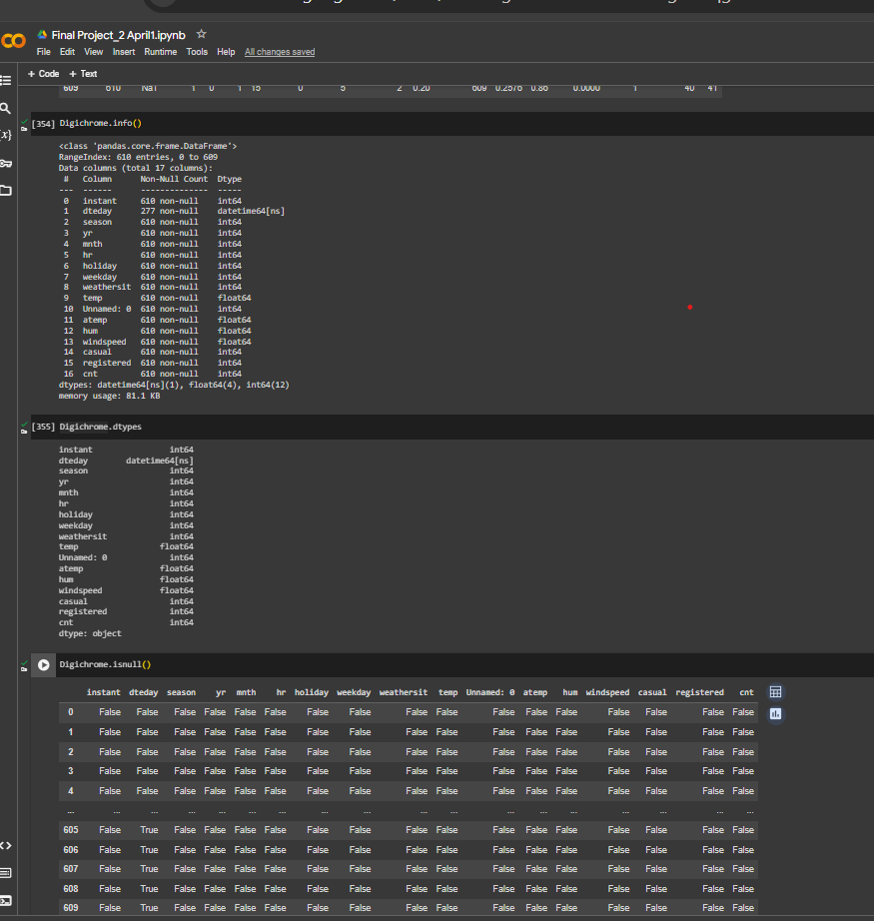

Slide 19
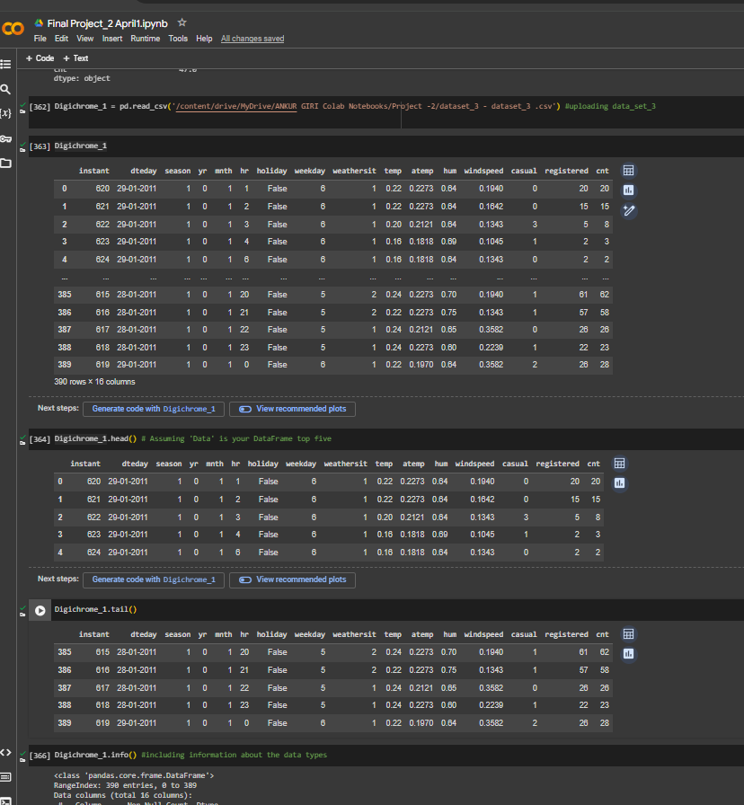
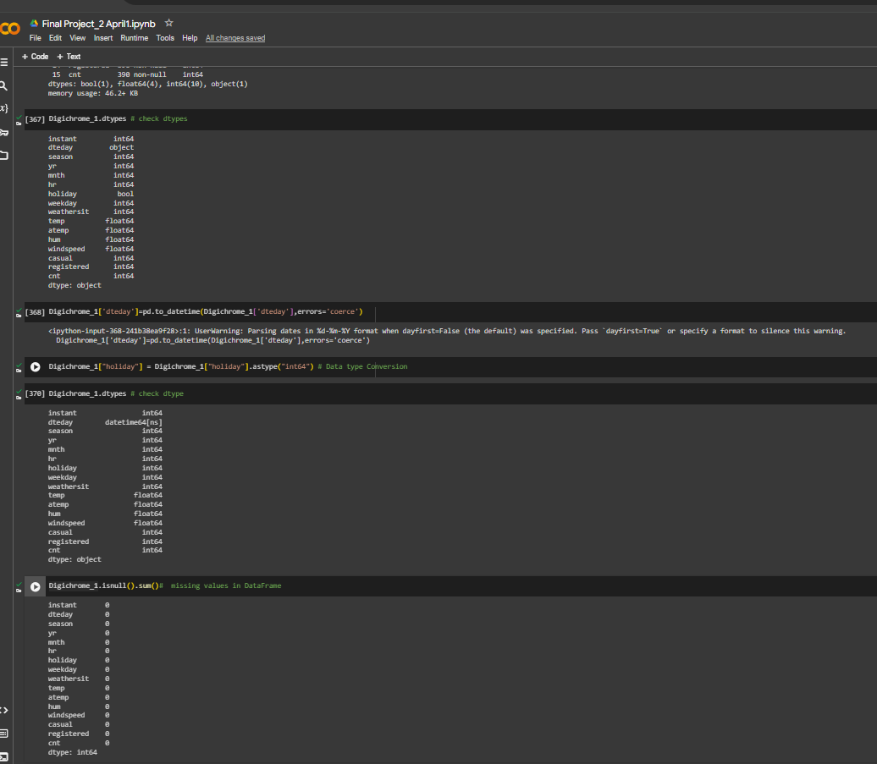

Slide 20
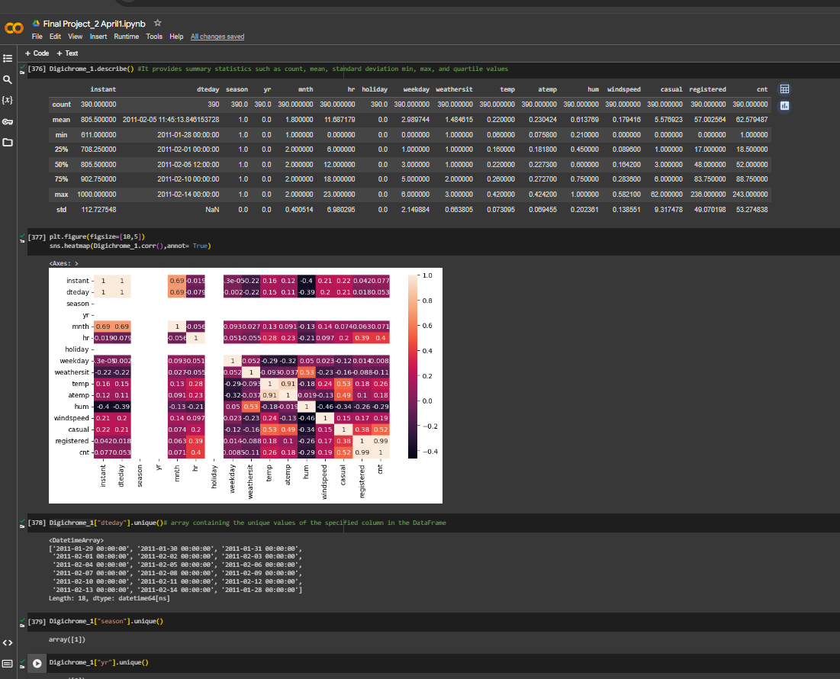
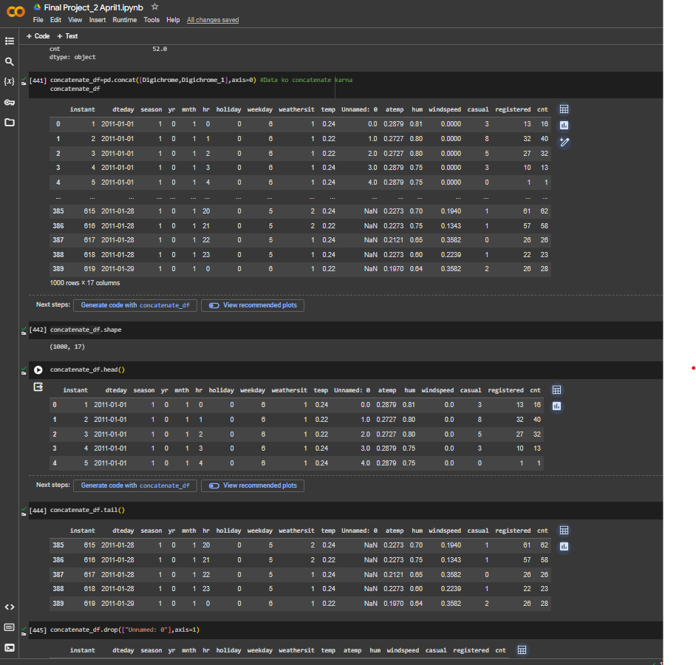

Slide 21
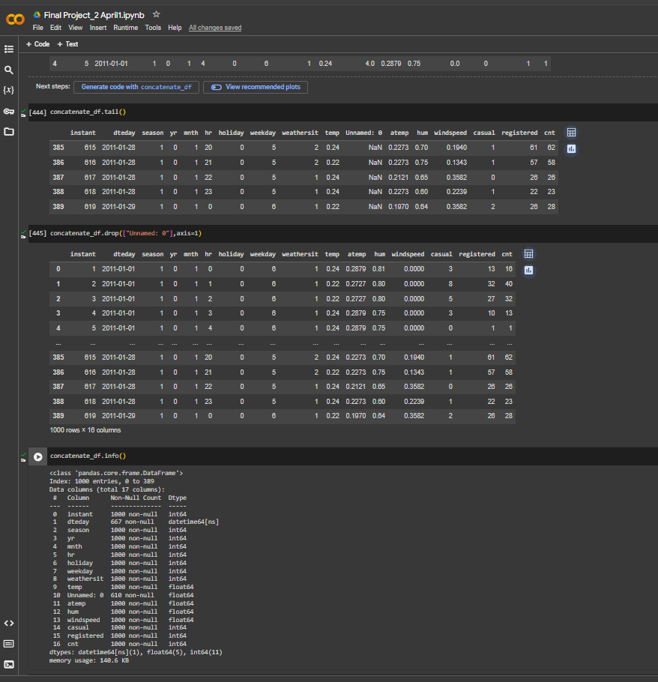
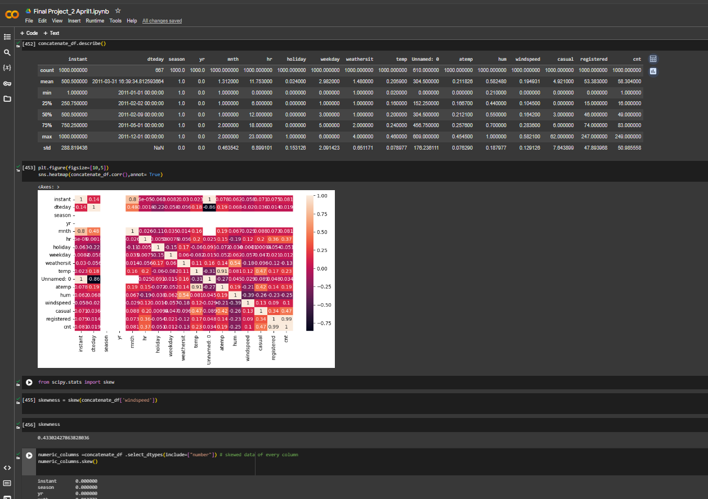

Slide 22
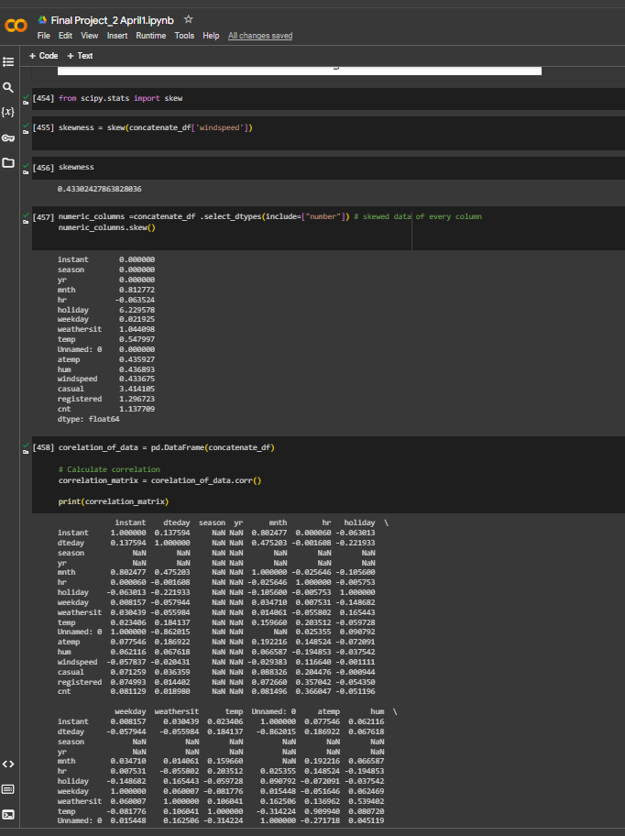
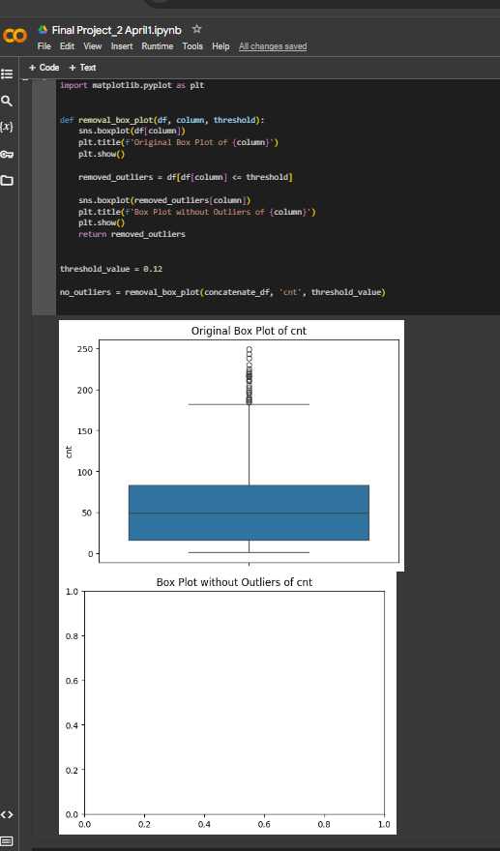

Slide 23
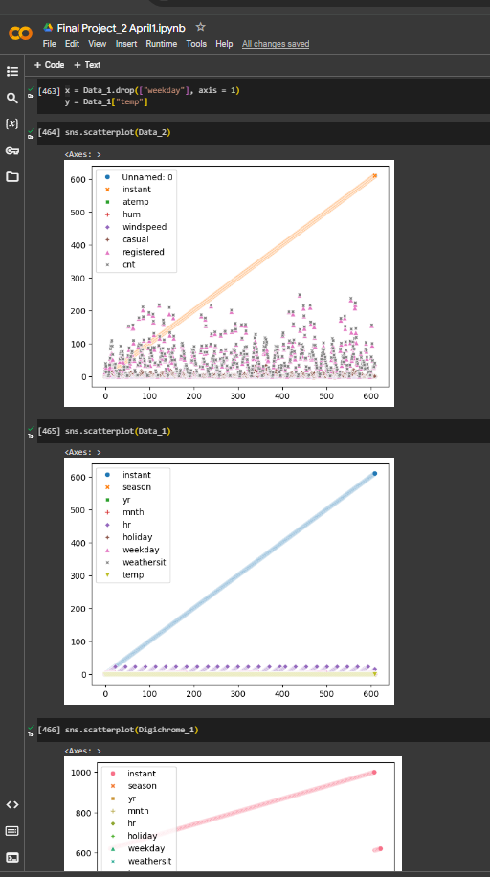
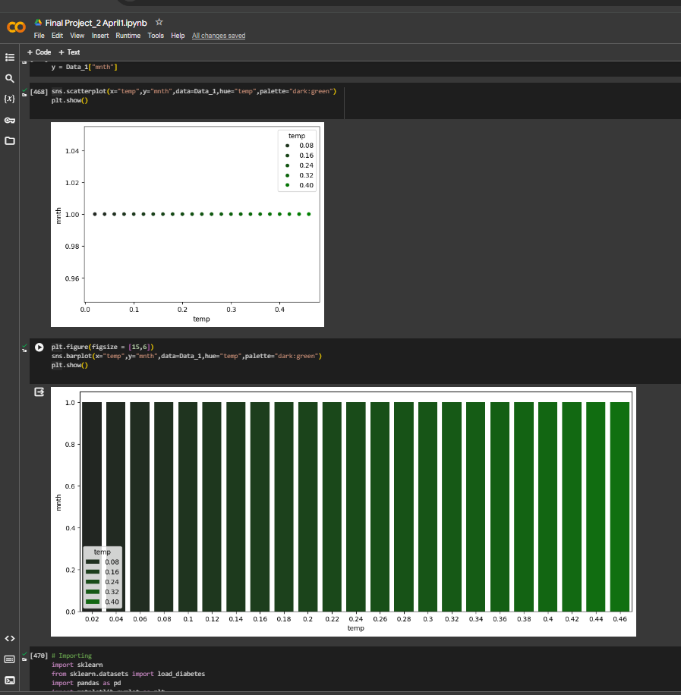

Slide 24
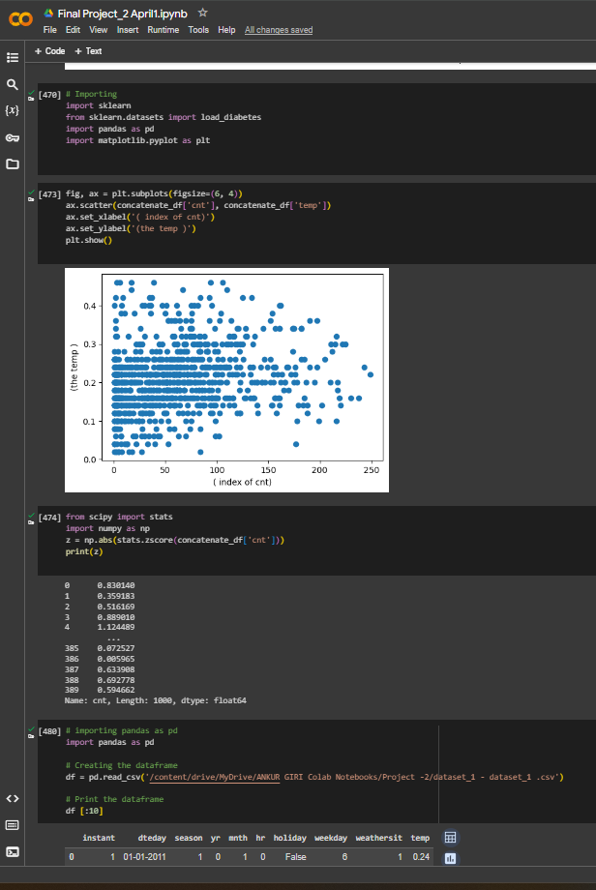
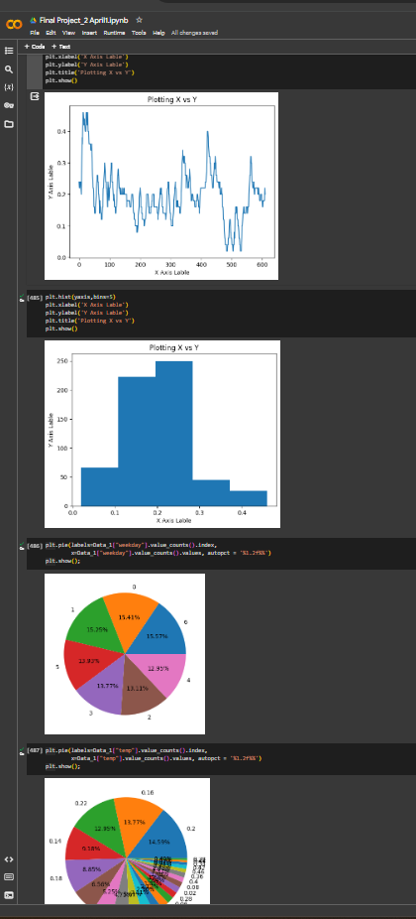

Slide 25
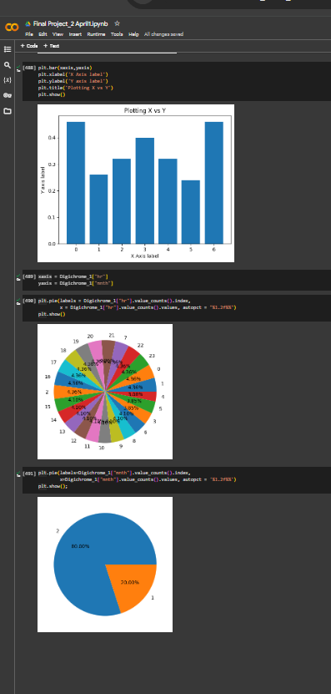

JAI HIND

